Slide 1
Opportunities Analysis
Uncovering Potential Revenue Streams and Market Expansion

Slide 2
Introduction to Shaun's Role and Analysis Purpose
Shaun, a Sales Director, is driving the Food Services Division. Promoted for stellar performance, Shaun now leads an analysis focused on customer spending patterns.
Purpose:
Uncover Opportunities: Identify new avenues for business growth.
Enhance Decision-Making: Understand customer preferences for strategic decisions.

Slide 3
Existing Customer Spend Overview

Slide 4
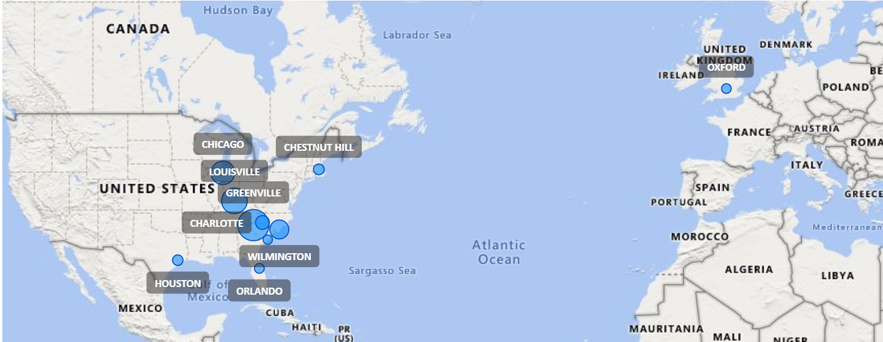
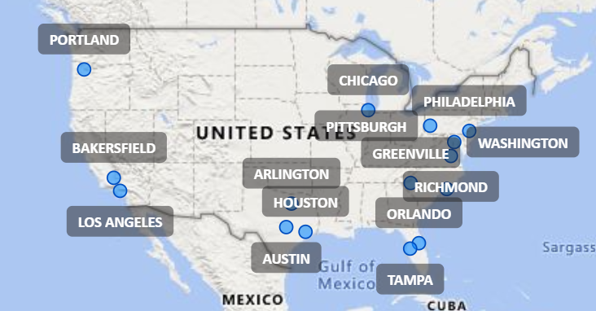
Top 10 Cities with Highest F&B Expenditure
Top 10 Cities with Highest Customer Concentration

Slide 5
Adjacent Opportunities - Non-Commercial Establishments
Non Commercial | City | Market Segment
BOSTON PUBLIC SCHOOL DISTRICT | BOSTON | SCHOOL DISTRICTS
FRANKLIN PUBLIC SCHOOL DISTRICT | FRANKLIN | SCHOOL DISTRICTS
HAVERHILL PUBLIC SCHOOL DISTRICT | HAVERHILL | SCHOOL DISTRICTS
NORTHEASTERN UNIVERSITY | BOSTON | 4 YEAR COLLEGE & UNIVERSITIES
NORTHERN ESSEX COMMUNITY COLLEGE | HAVERHILL | 2 YEAR COLLEGE & UNIVERSITIES
PEABODY PUBLIC SCHOOL DISTRICT | PEABODY | SCHOOL DISTRICTS
QUINSIGAMOND COMMUNITY COLLEGE | WORCESTER | 2 YEAR COLLEGE & UNIVERSITIES
SALEM STATE COLLEGE | SALEM | 4 YEAR COLLEGE & UNIVERSITIES
SHREWSBURY PUBLIC SCHOOLS | SHREWSBURY | SCHOOL DISTRICTS
SPRINGFIELD COLLEGE | SPRINGFIELD | 4 YEAR COLLEGE & UNIVERSITIES
SPRINGFIELD TECHNICAL COMMUNITY COLLEGE | SPRINGFIELD | 2 YEAR COLLEGE & UNIVERSITIES
SUFFOLK UNIVERSITY | BOSTON | 4 YEAR COLLEGE & UNIVERSITIES
UNIVERSITY OF MASSACHUSETTS | AMHERST | 4 YEAR COLLEGE & UNIVERSITIES
WESTFIELD PUBLIC SCHOOL DISTRICT | WESTFIELD | SCHOOL DISTRICTS
WESTFIELD STATE COLLEGE | WESTFIELD | 4 YEAR COLLEGE & UNIVERSITIES
WORCESTER PUBLIC SCHOOL DISTRICT | WORCESTER | SCHOOL DISTRICTS
WORCESTER STATE COLLEGE | WORCESTER | 4 YEAR COLLEGE & UNIVERSITIES
MASSACHUSETTS GENERAL HOSPITAL | BOSTON | HOSPITALS
TEWKSBURY HOSPITAL | TEWKSBURY | HOSPITALS
UMASS MEMORIAL MEDICAL CTR UNIV CAMPUS | WORCESTER | HOSPITALS
Number of meals per day range 2000+
Less competitive
More competitive
Enrollment range 5000+ at schools and university
Capacity Of Bed Range 500 To 1000 at Hospitals related area

Slide 6
Retailer Presence Near Customers
Name of Retail Store | City of Store | Market Segment
CHUCK EVANS' LIQUOR OUTLET | BOWLING GREEN | LIQUOR STORES
CROSSROADS 773 | BOWLING GREEN | GROCERY STORES
FOOD LION | FRANKLIN | GROCERY STORES
GREENWOOD SPIRITS SHOPPE | BOWLING GREEN | LIQUOR STORES
HOLIDAY FOOD WORLD | HOPKINSVILLE | GROCERY STORES
KROGER | FLORENCE, NEW PORT | GROCERY STORES
LIQUOR DIRECT | COVINGTON | LIQUOR STORES
PARTY TOWN | FLORENCE | LIQUOR STORES
PIGGLY WIGGLY | HOPKINSVILLE | GROCERY STORES
SAVE-A-LOT | ELKTON | GROCERY STORES
STADIUM LIQUOR STORE | COVINGTON | LIQUOR STORES
UNITED DAIRY FARMERS | FLORENCE | CONVENIENCE STORES
Annual Sales more
1 M+
Less competitive More competitive

Slide 7
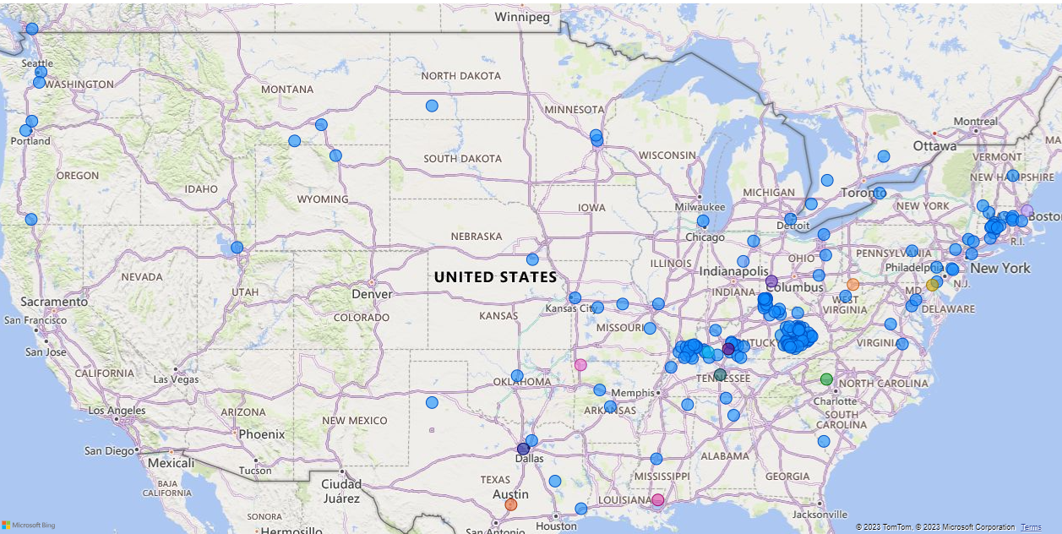
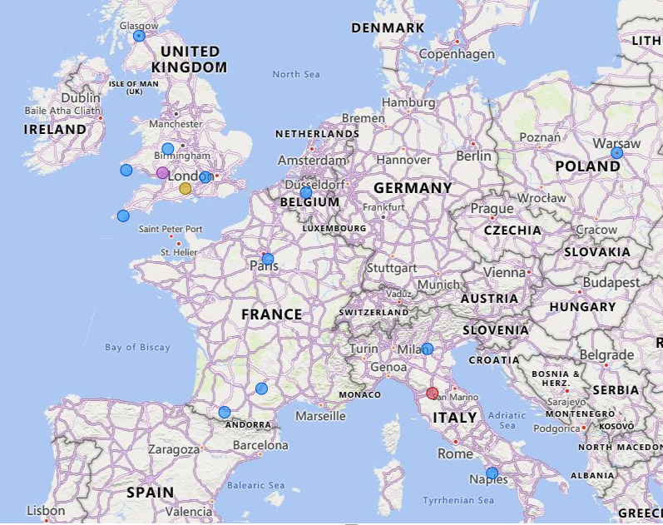
Cities of Thriving Retail Opportunities
NEWPORT (KROGER) | HICKORY
ARLINGTON | HOPKINSVILLE
AUSTIN | MARION
BOWLING GREEN | MORGANTOWN (SAVE-A-LOT)
COVINGTON | UNION
DAYTON | ROGERS
ELKTON ((SAVE-A-LOT) | SALEM
FLORENCE (KROGER) | SALISBURY
FRANKLIN
Less competitive cities More competitive cities

Slide 8
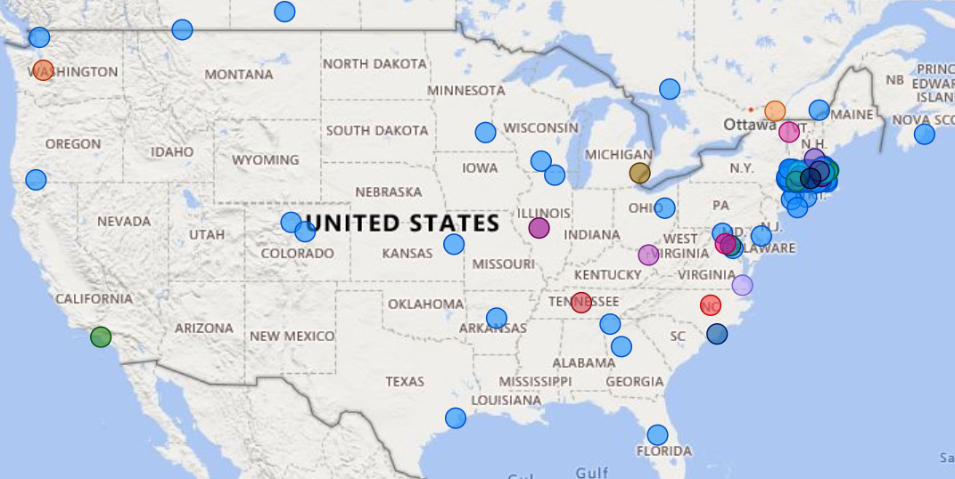
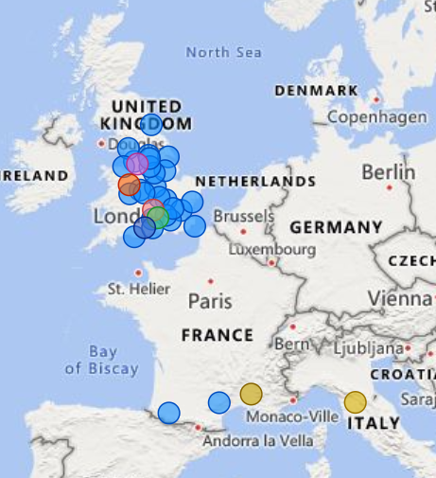
Cities of Thriving Non commercial Opportunities
AMHERST | OXFORD | WILMINGTON
HUNTINGTON | SHREWSBURY | GLOUCESTER
FLORENCE | STERLING | MANCHESTER
WARREN | WORCESTER | SALISBURY
WESTFIELD | CONCORD | PEABODY
SPRINGFIELD | HUDSON | SALEM
GREENFIELD | BURLINGTON | FRANKLIN
ORANGE | HAVERHILL | NORFOLK
WENDELL | GEORGETOWN | WESTWOOD
AUBURN | READING | BOSTON
Less competitive cities
More competitive cities

Slide 9
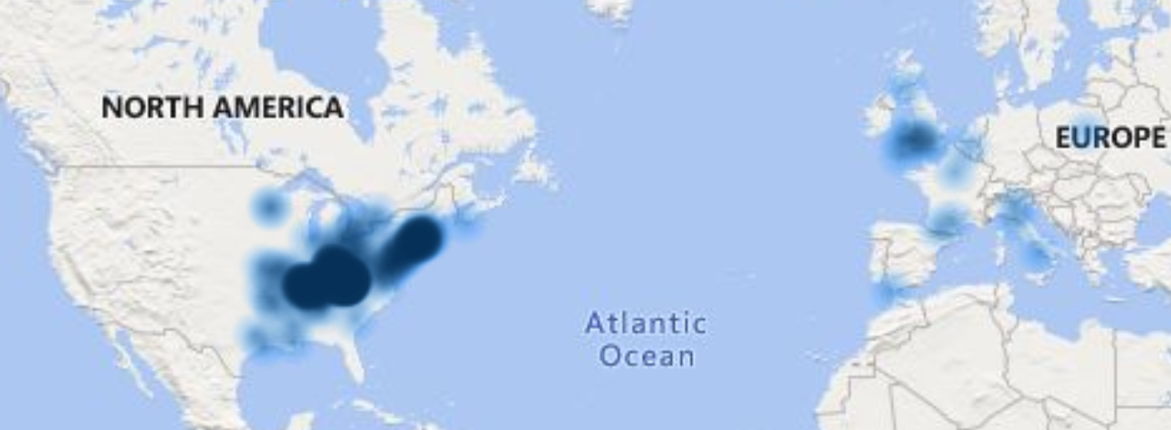
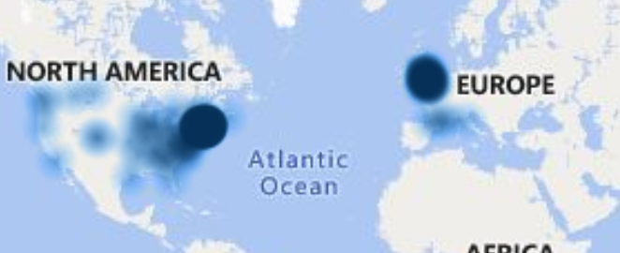
Opportunity Heat Maps: Non-Commercial and Retailer Segments
Retailer Segments
Non-Commercial
This heat map provides a visual overview of retailer opportunities within different geographic regions.
By utilizing color gradients, the map highlights the varying degrees of potential in these areas, giving a quick snapshot of where retailer presence is more pronounced and where opportunities may be ripe for exploration.
Darker shades indicate areas with higher competition, while lighter shades represent regions where competition may be less intense.
Above heat map offers a visual representation of non-commercial opportunities across various geographic areas.
The color gradients on the map signify the level of competition, providing a quick and insightful overview of where opportunities may be more abundant and where competition is more intense.
Darker shades indicate areas with higher competition, while lighter shades represent regions where competition may be less intense.

Slide 10
Thank You

